Slide 1

PANCASILA AS A
DEVELOPMENT PARADIGM
Group 8 Class 1I

Slide 2

OUR GROUP
Shofa Yasmin Fauziah 2241720108/23
Shofwah Kanaka Ebsa Anargya 2241720254/24
Sri Kresna Maha Dewa 2241720244/25

Slide 3




WHAT IS
PARADIGM & DEVELOPMENT ?
CONCLUSION
THE PURPOSE AND TERMS OF PANCASILA
VARIOUS

Slide 4


THE PURPOSE AND
TERMS OF PANCASILA

Slide 5

MEANING
According to Moh. Yamin, in Sanskrit the word Pancasila has two kinds of lexical meanings, namely panca which means five and syila which means joint stone or base.
As the foundation and ideology of the state, Pancasila, which is extracted from the culture of the Indonesian people, has a very broad role and function in the life of the nation and state. in the life of the nation and state. Function and Role Pancasila continues to develop in accordance with the demands of changing times.

Slide 6

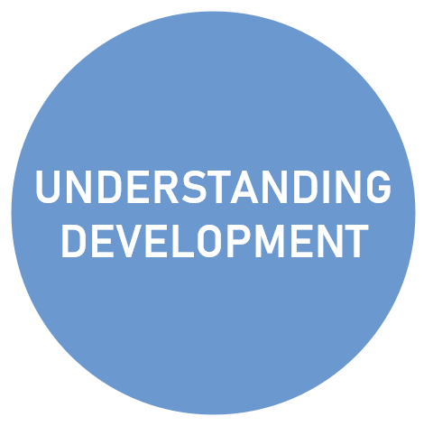
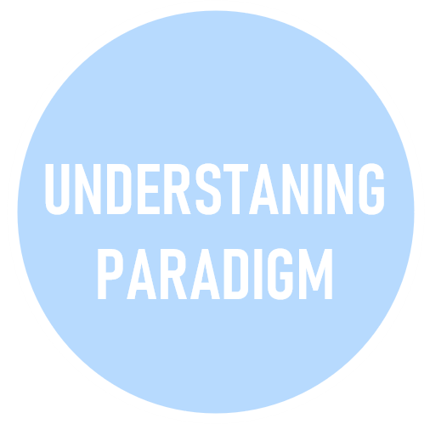
WHAT IS
PARADIGM & DEVELOPMENT ?

Slide 7
!
UNDERSTANING PARADIGM
in English, where it is understood to denote the state of the environment.
in Greek, Para, which means beside, next to.
The psychological dictionary then describes a paradigm as a model or pattern that exhibits every function necessary to support what is being given.
Pancasila as a paradigm means that the basic values of Pancasila normatively become the basis, frame of reference, benchmark for all aspects of national development carried out in Indonesia. This is a consequence of the recognition and acceptance of the Indonesian nation of Pancasila as the basis of state and national ideology. Pancasila is the basis of the Indonesian state, while the state is an organization or fellowship of human life, it is not excessive if Pancasila becomes the basis and benchmark for state administrators, including in carrying out development. Development includes political, economic, socio-cultural, and legal fields.

Slide 8
!
UNDERSTANING DEVELOPMENT
Development is growth, expansion related to conditions that must be explored and built in order to achieve progress in the future
National development is a series of sustainable development efforts to cover the entire life of society, nation and state to carry out the task of realizing national goals as stated in the preamble of the 1945 Constitution.
The essence of national development is the development of Indonesian people as a whole and the development of all Indonesian people carried out in an integrated, directed and continuous integrated plan to increase national capabilities, so that they are on par with other nations.
In the context of this discussion, Pancasila becomes a development paradigm, meaning that Pancasila is a framework or benchmark for development in Indonesia.

Slide 9





VARIOUS

Slide 10

Pancasila as a Development Paradigm in Politics
By using Pancasila as a political paradigm, one means to use its principles as a foundation for political principles. All political practices must be developed on the basis of populist ideals, according to the 4th precept of Pancasila, which serves as the foundation for all political beliefs.
The power in question is power that belongs to, is used by, and is controlled by the people. The political system in Indonesia that follows Pancasila as a paradigm is a democratic one, not an authoritarian one.
As an end, the fourth Pancasila principle, or the principle of the people, must serve as the foundation for the development of the Indonesian political system.
The second change is that moral ideals, rather than Pancasila's rules, now form the foundation of the governmental system.

Slide 11

Pancasila as a Development Paradigm
in Law
One of the objectives of the Indonesian state is to demonstrate the bloodshed of the entire Indonesian nation.
All facets of the country are to be considered by the system and security. The term "universal people's security system" refers to Indonesia's development and security framework.
As stated in MPRS Decree No. XX/MPRS/196 Since Pancasila is the foundation of all laws, all rules and regulations in Indonesia must not conflict with it because it is the State Foundation. Nobody, not even the MPR, has the authority to alter the preamble of the 1945 Constitution, which incorporates Pancasila. This is based on Articles 3 and 37 since the breakup of the state results from modifications to the preamble

Slide 12

Pancasila as a Development Paradigm in Economic
The Pancasila Paradigm in economics states that the foundation of the economic system must be humanism and divine morality.
According to Article 33 of the 1945 Constitution, free competition and monopolies are not permitted in the economy.
The explanation of the 1945 Constitution states thus about Article 33: "Production is carried out by everyone, for all, under the leadership or ownership of members of the community.
This is the basis of economic democracy.
The welfare of the populace must therefore be given priority in the state's economic structure

Slide 13

Pancasila as a Development Paradigm in Social-Cultural
Pancasila is a normative source that seeks to elevate human dignity in the context of social-cultural development. make citizens into a society that is cultured and civilized.
In the age of globalization, western cultures that have invaded Indonesia have started to bury cultural values that have grown in society
The government has a responsibility to remind and direct the people to reapply cultural elements based on human values, divine values, and civilized values.

Slide 14

CONCLUSION
Paradigm is the basic view of scientists about what is the subject matter of a branch of science. The term paradigm is increasingly developing not only in the field of science, but in other fields such as political, legal, social and economic fields. Pancasila is referred to as a paradigm in national and state life.

Slide 15
THANK YOU

